Slide 1
Eyeball Documentation
Sofia P

Slide 2
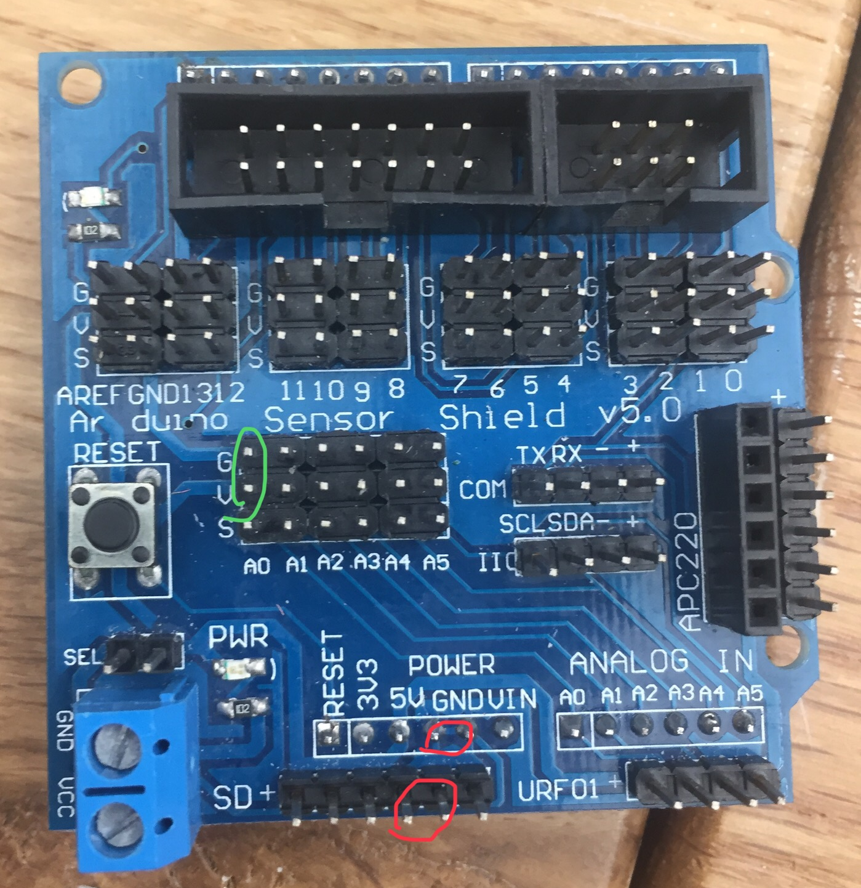
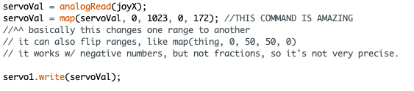
Learning Arduino & Testing the Sensors
When learning how to use the Arduino & Arduino shield, I thought that power went through the red pins, not the green ones, so I was stuck for a while getting a lot of noise.
Later, I followed this video: https://www.youtube.com/watch?v=kA_pbMR6jVs&t=127s to learn how to translate the joystick’s movement to a servo’s movement. Here I learned the map() function.

Slide 3
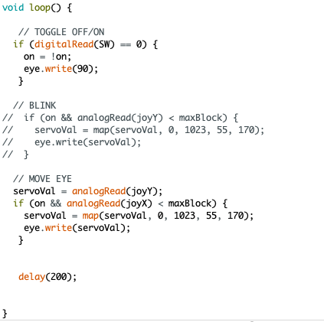
Coding the Eyeball
← I added on a way to turn the eye on and off, using the joystick’s switch.
← Here, instead of following the original project’s code, I ended up continuing to use the map() command again to move the eye.

Slide 4
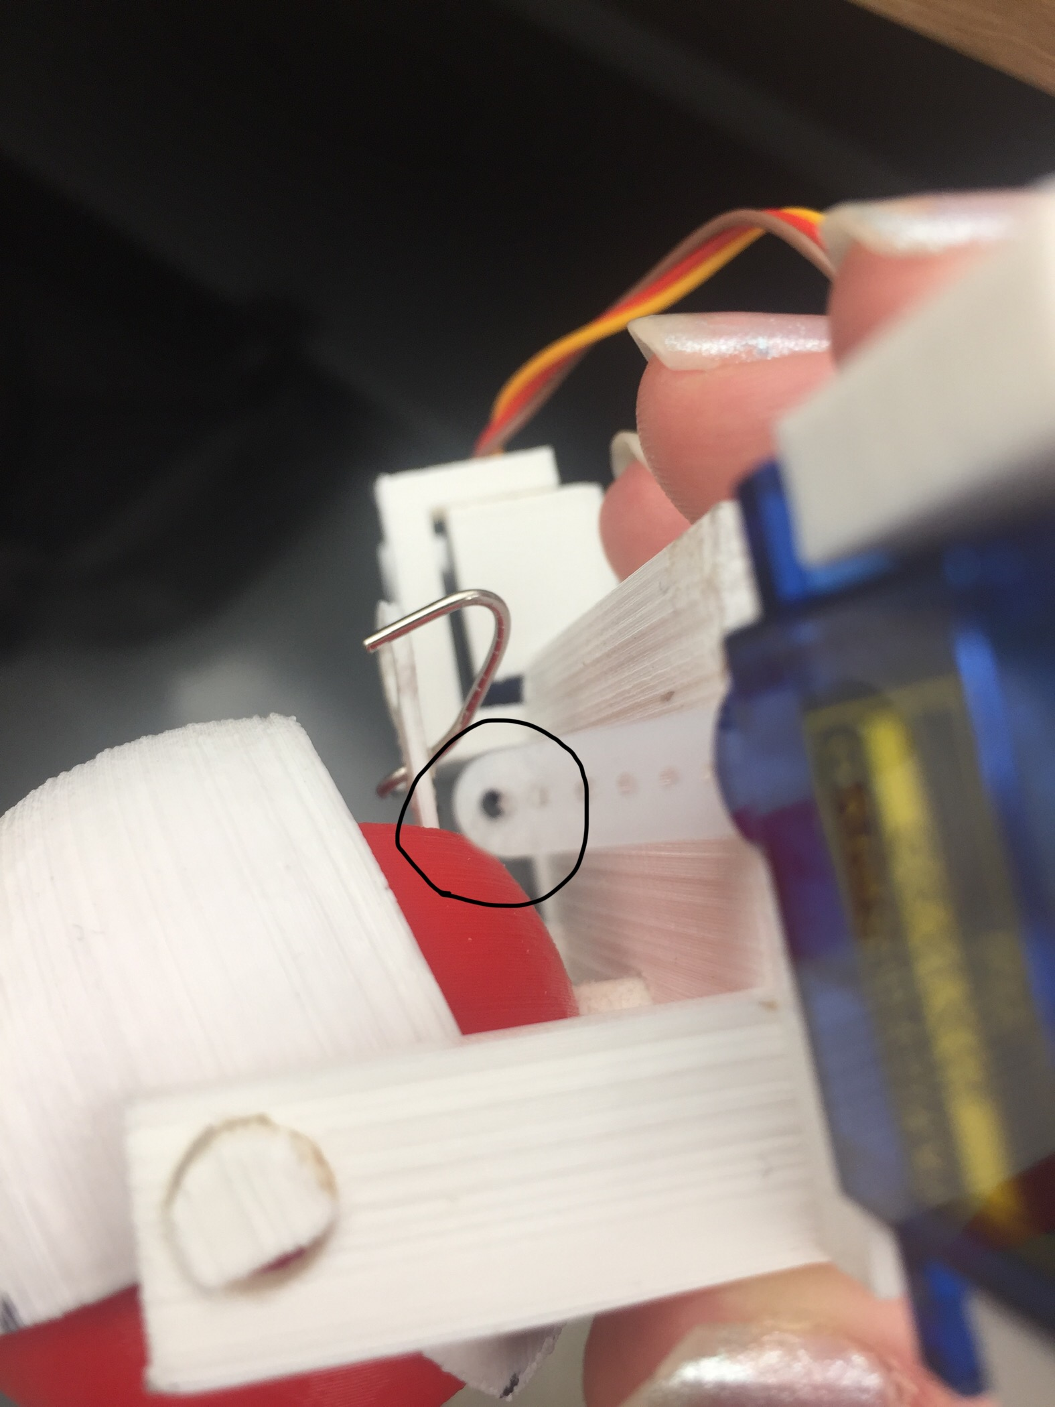
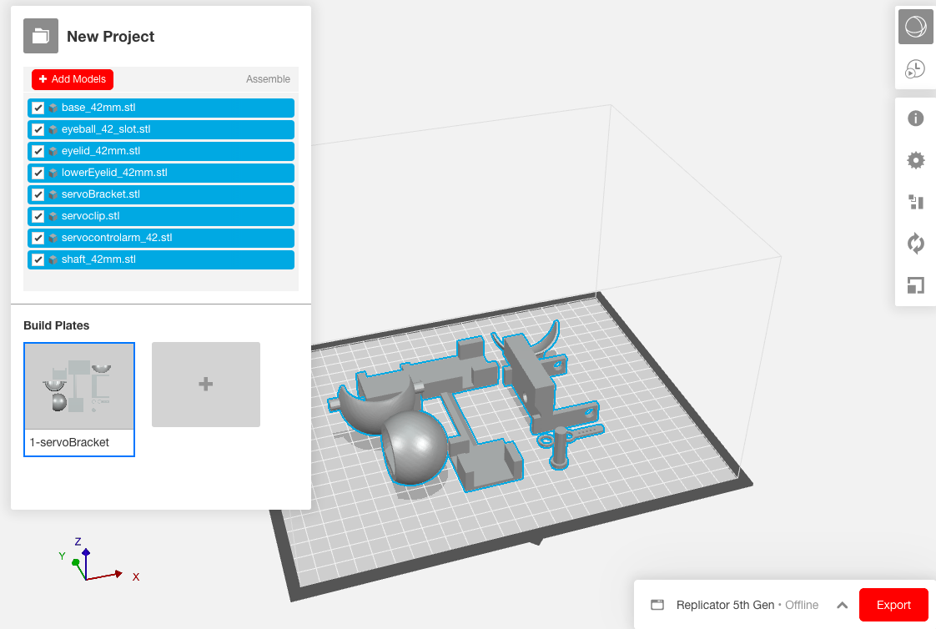
Building the Eyeball:
I tried using makerbot & the 3D printers, and I drilled the servo’s arms so that a paperclip could fit through it. I also had to use a lot of sanders to smooth down the 3D printed parts.

Slide 5
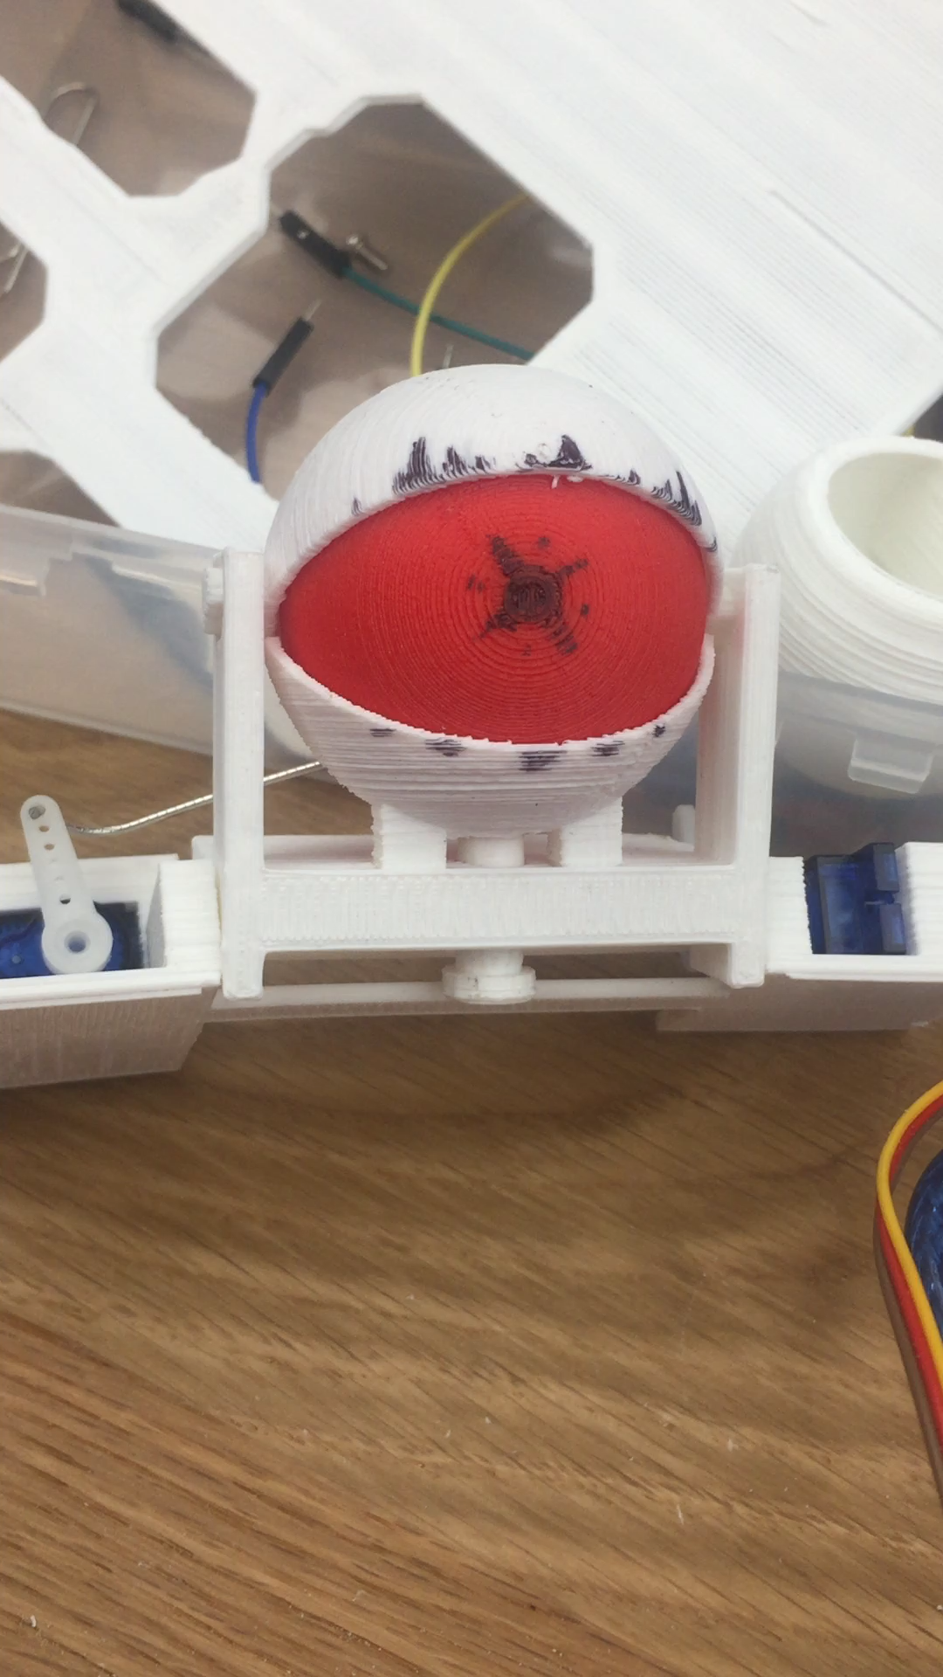
I got the eyeball shifting to work!

Slide 6
Moving further: trying to use my webcam as a sensor, and make the eye react to it

Slide 7
Processing & Arduino
While looking around for ways to connect the Arduino to my computer’s webcam, I found this project that uses a program called Processing: http://onuravun.blogspot.com/2013/08/using-nokia-5110-screen-as-primitive.html.
I started learning how to communicate between Processing and Arduino, using https://learn.sparkfun.com/tutorials/connecting-arduino-to-processing/all.

